Slide 1
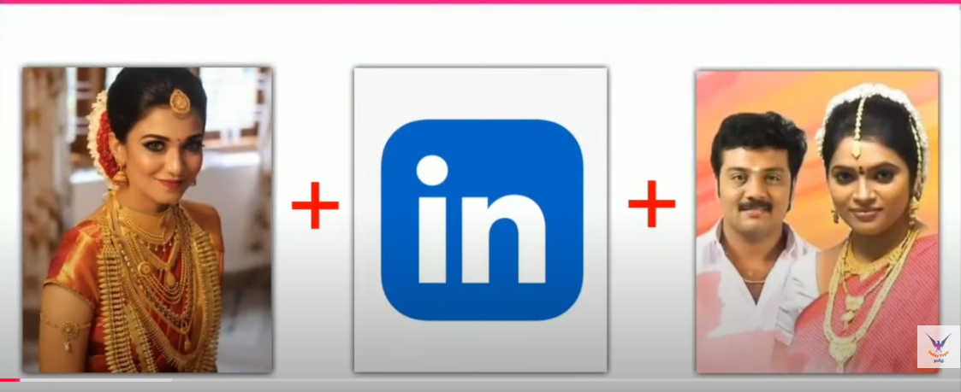
Guess the movie name ?

Slide 2
Hint
1. Director is Mani Rathnam
2. Based on Famous Novel

Slide 3
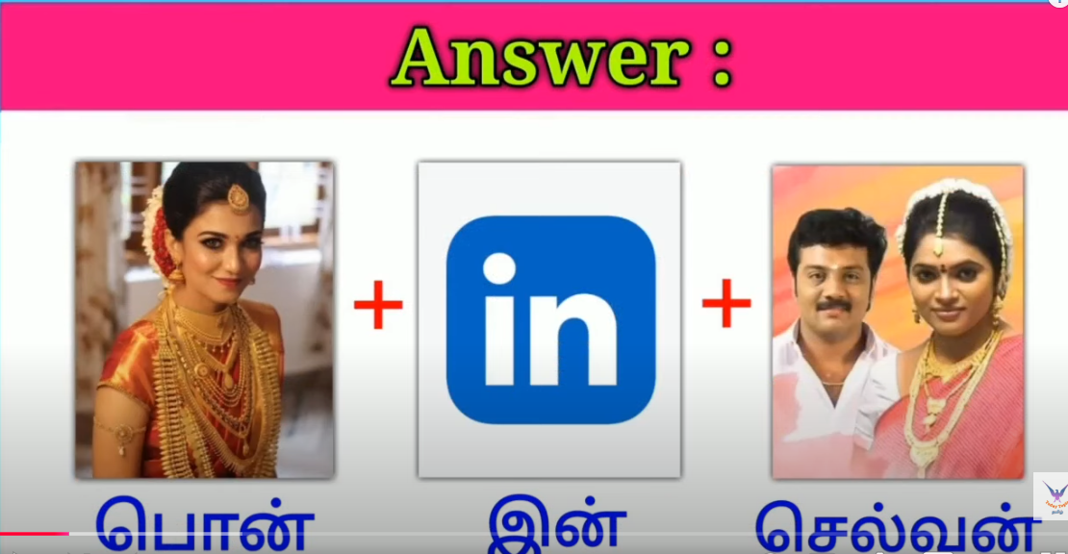

Slide 4

movie Name is

Slide 5

Guess the movie name ?

Slide 6
Hint
1. Director is Vetrimaran
2. A police officer is recruited to capture the leader of a separatist group

Slide 7
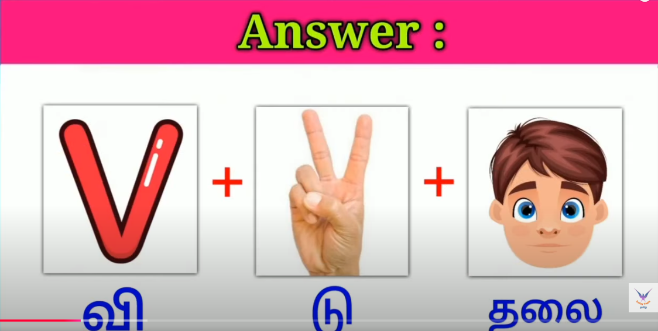

Slide 8

movie Name is

Slide 9
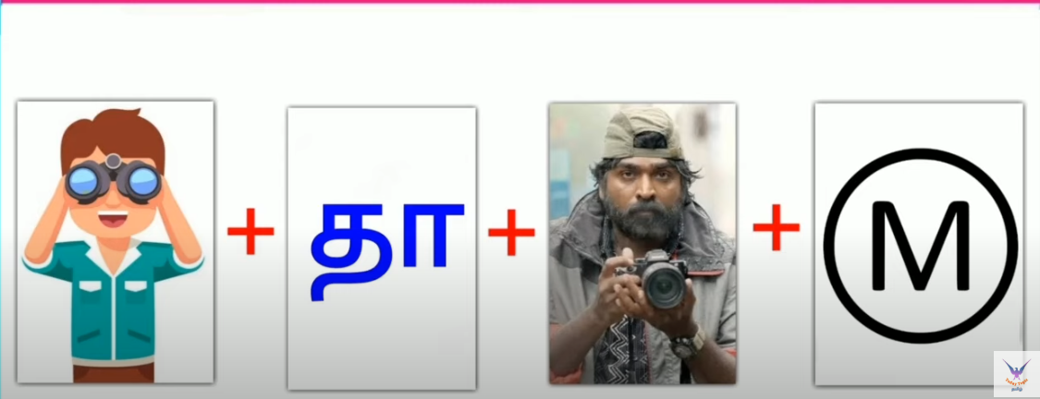
Guess the movie name ?

Slide 10
Hint
1. Director is Hanu Raghavapudi
2. An orphan soldier, Lieutenant Ram's life changes, after he gets a letter from a girl named Sita. He meets her and love blossoms between them. When he comes back to his camp in Kashmir,After he gets caught in jail, he sends a letter to Sita which won't reach her.

Slide 11
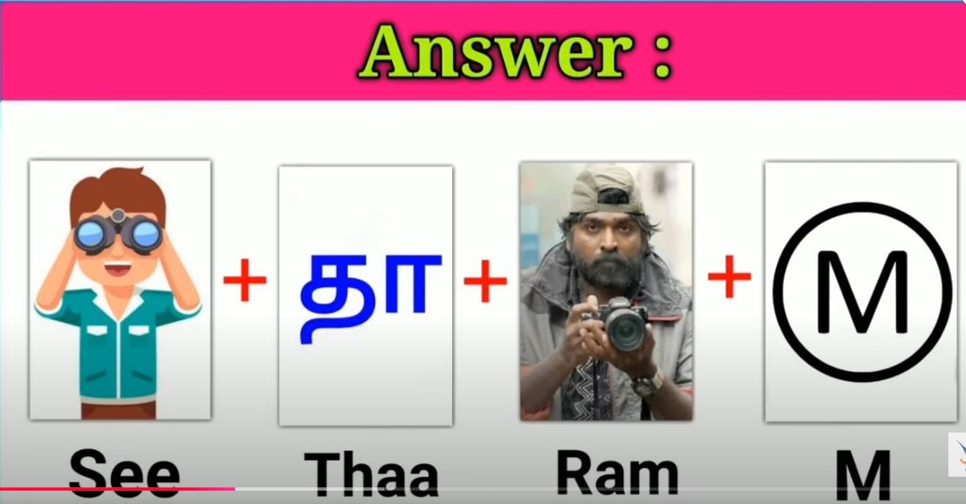

Slide 12

movie Name is

Slide 13

Guess the Song name ?

Slide 14
Hint
1. Hero is Sivakarthikeyeh

Slide 15

SONG Name is

Slide 16

Guess the Song name ?

Slide 17
Hint
1. Heroes are Jai and Sasikumar

Slide 18

SONG Name is

